Slide 1




WordNumber
Notes:
07/12/2025
1
1

Slide 2

Table of contents :
1.Our Team
2.Stages of Realization
3.Used Technologies
Notes:
07/12/2025
2
2

Slide 3
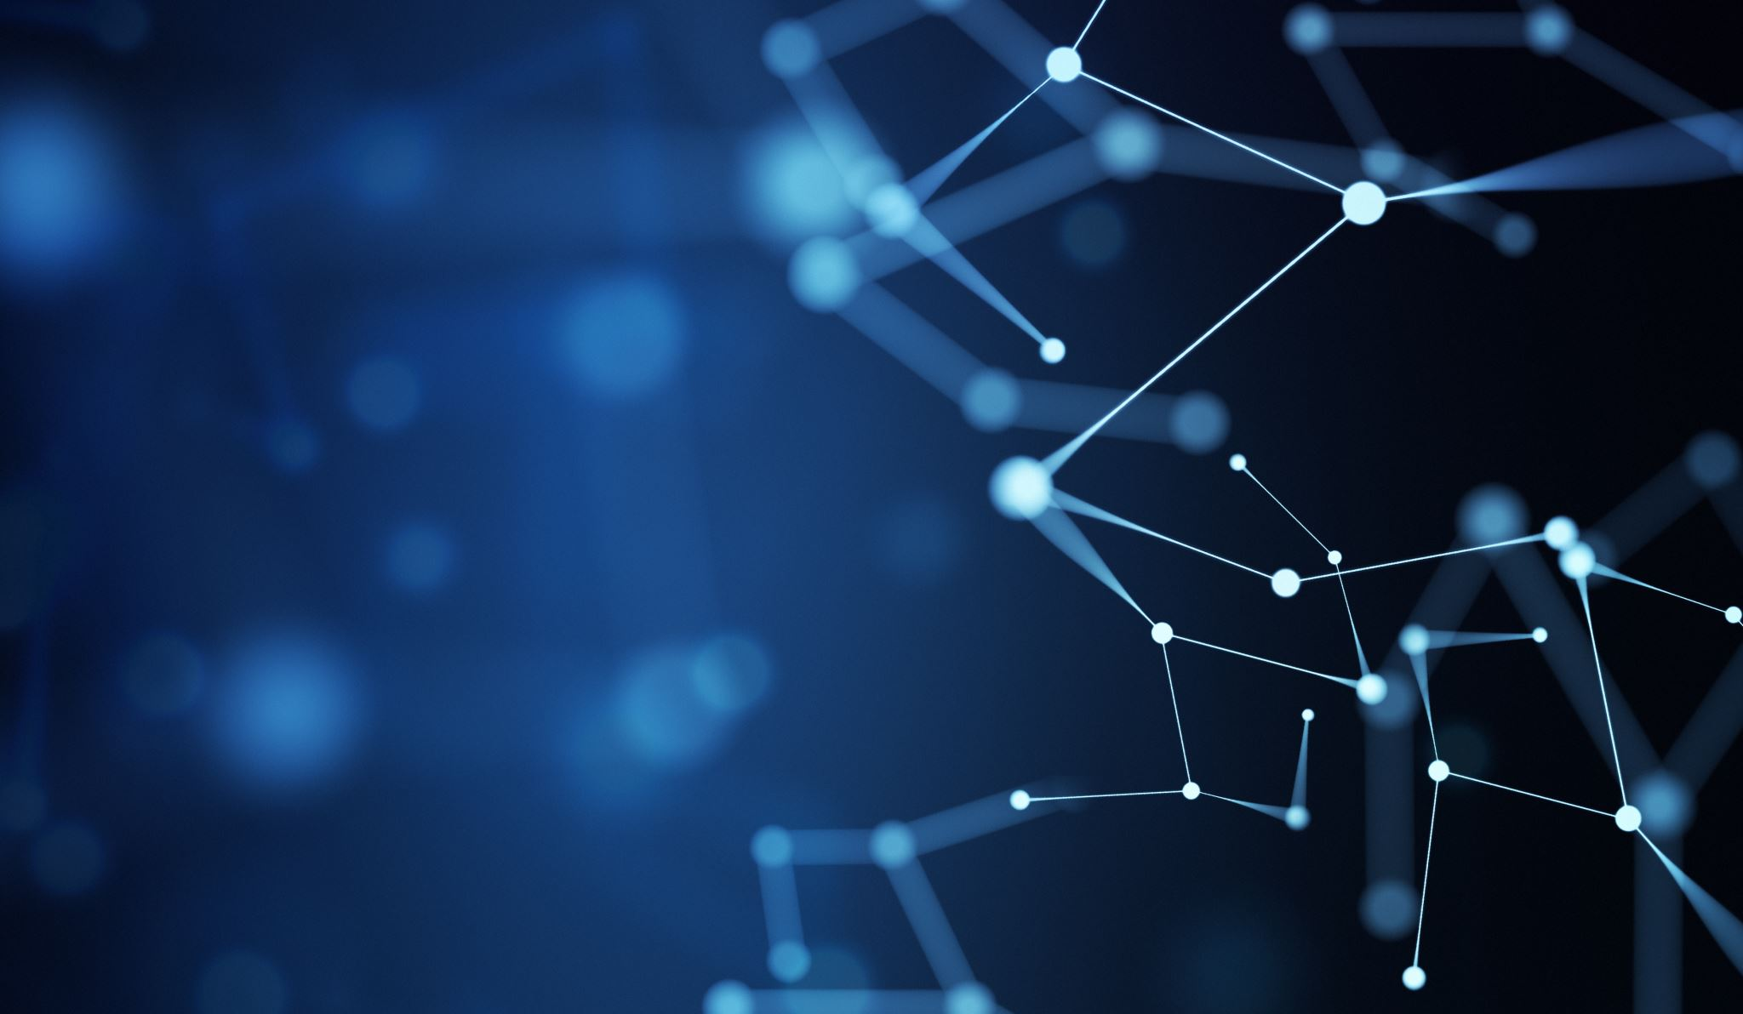
01. Our team
And everything you should know about us;)
Notes:
07/12/2025
3
3

Slide 4
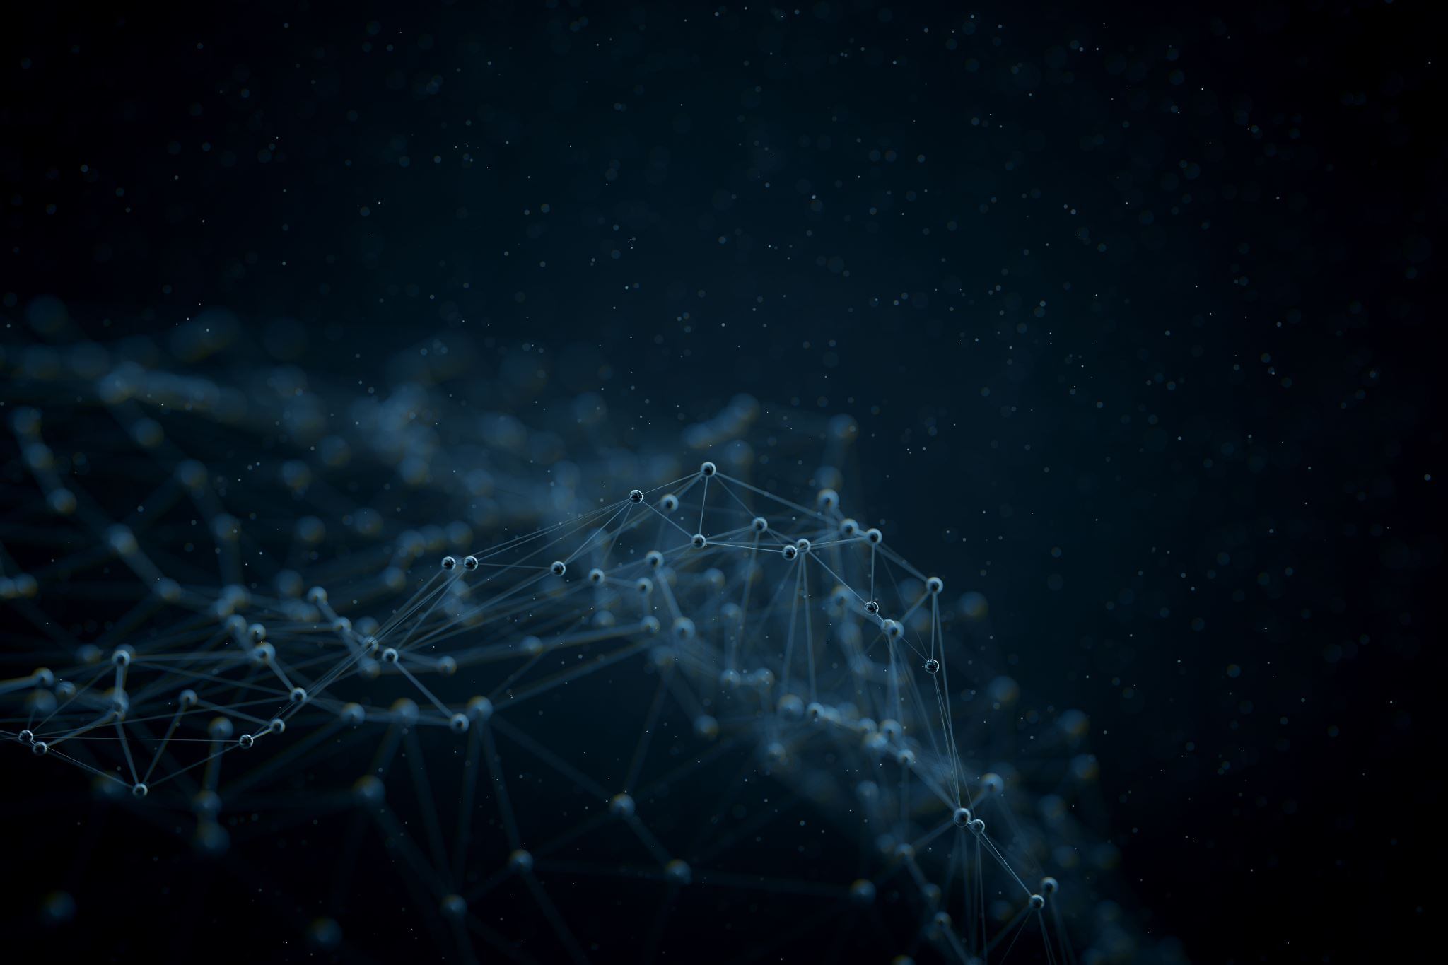
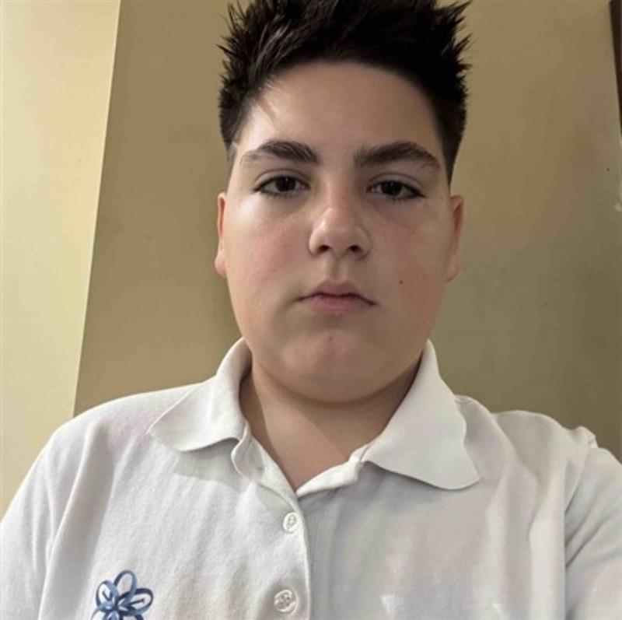
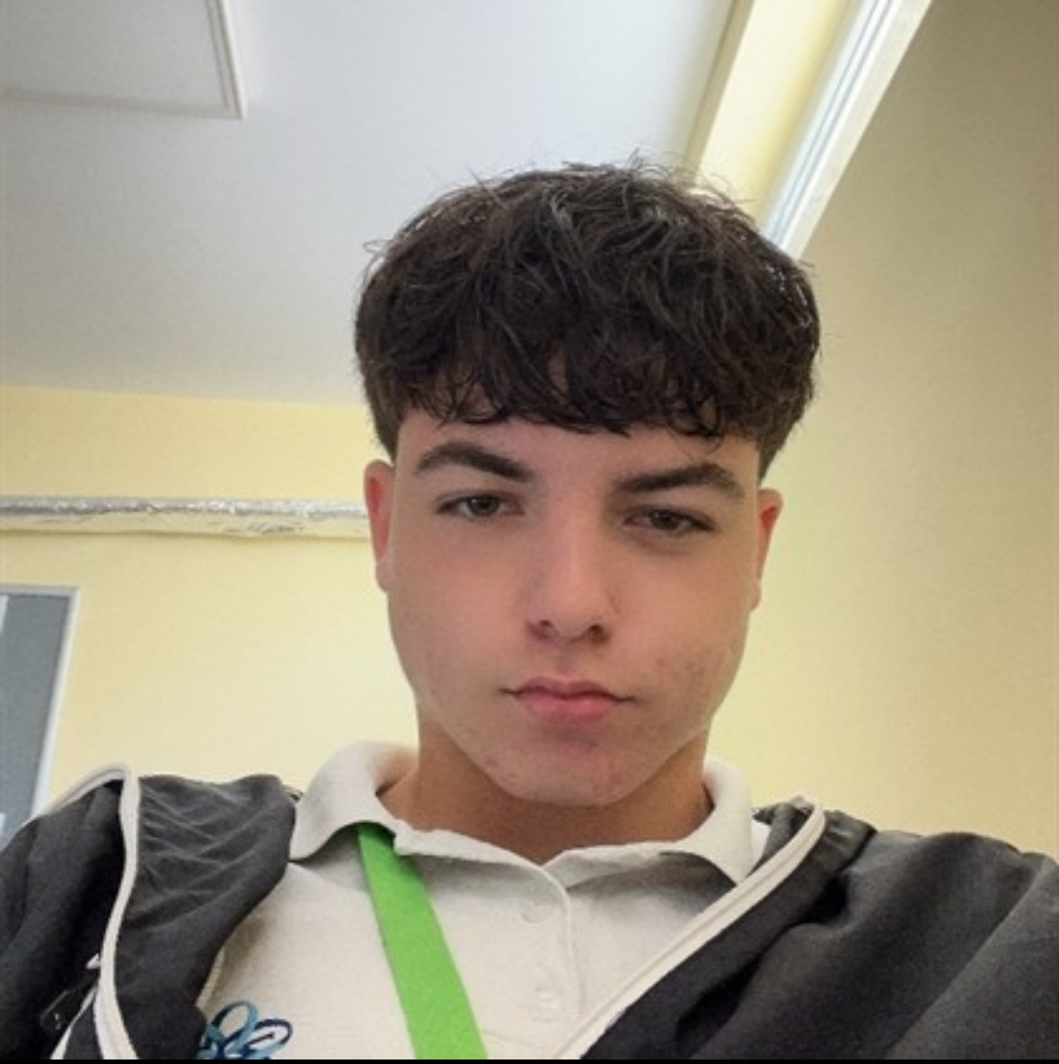
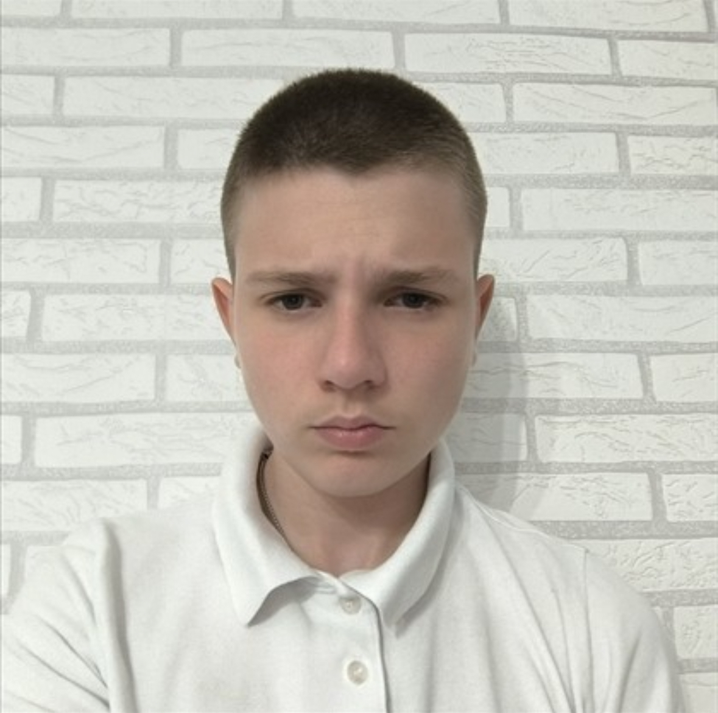
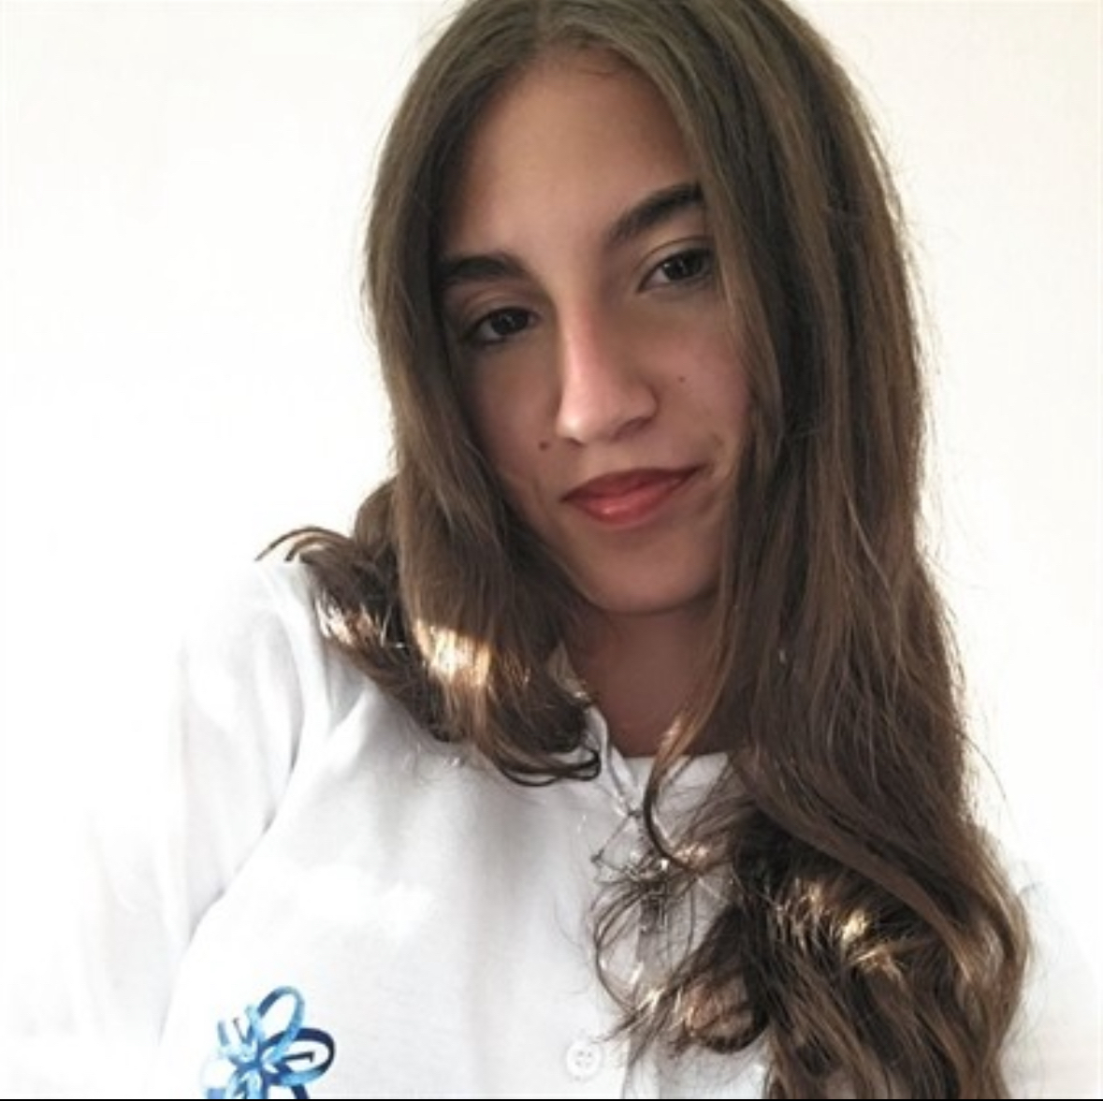
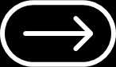
Our team:
Stoyan Tanev
Scrum Trainer
Kristiyan Georgiev
Designer
Vilian Ivanov
Dara Sokrateva
BackEnd Developer
BackEnd Developer
Notes:
07/12/2025
4
4

Slide 5

02. Stages of Realisation
And how we came up with the idea
Notes:
07/12/2025
5
5

Slide 6


Stages of realisation
Our presentation is about a Hangman-style game we created in C++. We worked together to write clear, organized code and uploaded all our progress to GitHub with regular commits. We also made documentation explaining how the game works and what each team member contributed. By working in our different roles, we were able to complete the project successfully.
Notes:
07/12/2025
6
6

Slide 7
03. Used technologies
Notes:
07/12/2025
7
7

Slide 8









03. Used technologies
Notes:
07/12/2025
8
8

